Slide 1

JAWED HABIB HAIR & BEAUTY
BUSINESS INTELLIGENCE AND BUSINESS ANALYTICS PROJECT
Aditya Kumar Singh
Aryan Rajput
Javed Mohammed

Slide 2

INTRODUCTION
With a rich history dating back to 1940s, Javed Habib Hair and Beauty has been
at the forefront of hair styling, hair dressing and pretty much everything to do
with hair. It has 850 sister branches and 65 hair academies across 115 cities.

Slide 3
Process
As a part of the Business Intelligence team, the key goal was to improve the current process and keep loyal customers. Since Jawed Habib Hair & Beauty Salon has a stronghold on the industry. The funds are being used to maintain the existing foundation. The following procedures were finalized and will be implemented in accordance with our scope:
NO SHOWS AND CANCELLED APPOINTMENT HANDLING.
CUSTOMER FEEDBACK SYSTEM.
FREQUENCY DISCOUNT MOTIVATION.

Slide 4
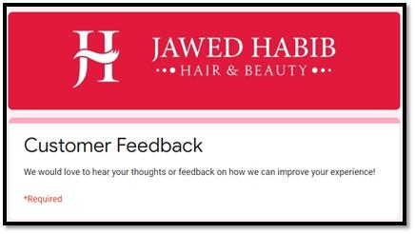
Process Design
Customer Feedback Design
Customer feedback is the most important source of knowledge that can be used to boost a company's credibility. A feedback type is created for this purpose. Customers will be emailed the current connection to access the feedback form.
Since the reviews would be sent by mail. It is important to have a large logo so that the customer does not wrongly mark the email as spam.

Slide 5
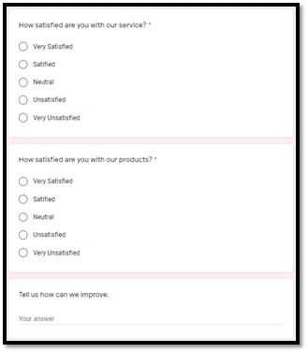
A good feedback layout is descriptive and offers as much detail as possible. Long questions with a lot of choices appear to put the input provider on the defensive. Short queries, on the other hand, do not provide any details.

Slide 6
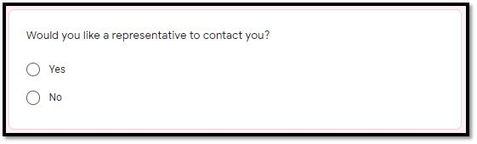
These problems, as seen above, will not irritate customers and will inspire them to actively fill out the document.
The best way to give a general multiple-choice question with an explicit place for comment review.

Slide 7
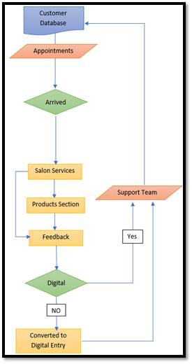
In the scenario that a customer needs to provide input and schedule an appointment at the same time. There is a choice available. The client may be discouraged from booking if the route is longer and more difficult.

Slide 8
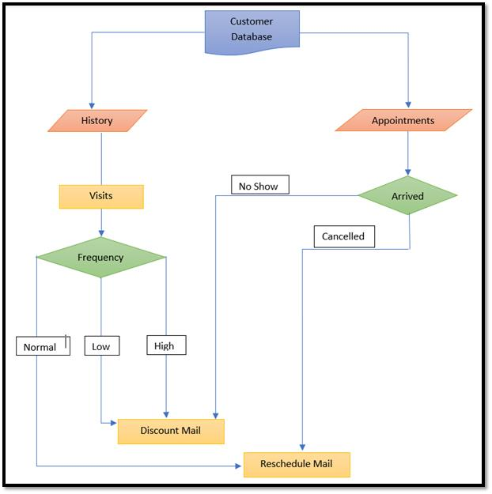
The complete process is illustrated in the flow chart above, with the suggestions directed at those who attended the salon.

Slide 9
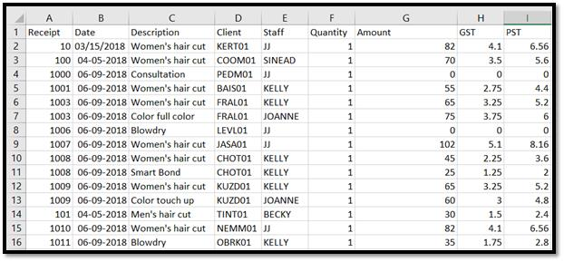
DataSet Directory
This dataset includes information about a customer's payment. It includes the revenue generated as well as the employees who contributed to the latter. It's also possible to find out which employees have the most bookings. The date and time columns refer to the peak days of year for business
Receipt Transactions:

Slide 10
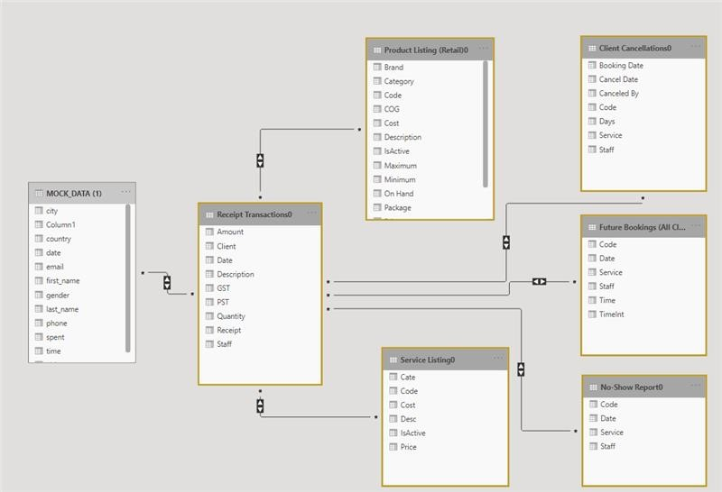
Database Design
One of the most crucial aspects of any project is database design. The most important aspects of the organization should be stated explicitly and concisely. The database architecture of the database is depicted in the diagram below

Slide 11
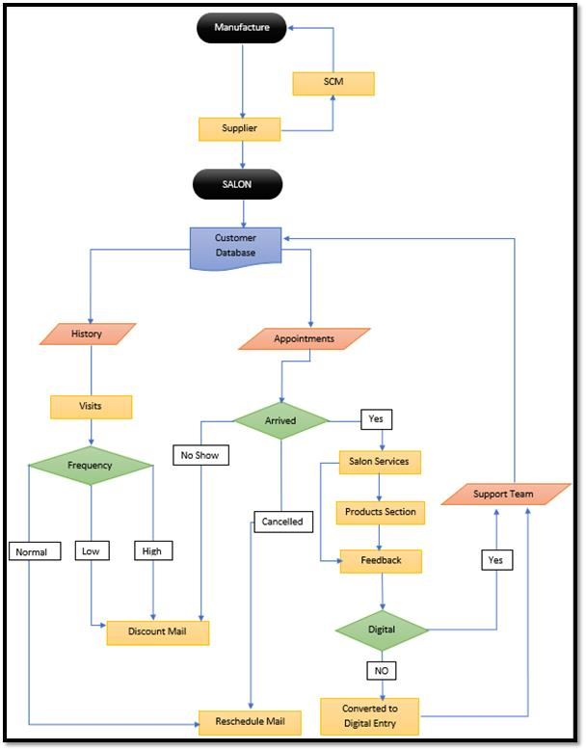
Product Life Cycle
The flow chart below will explain us about the complete product life cycle the business model

Slide 12
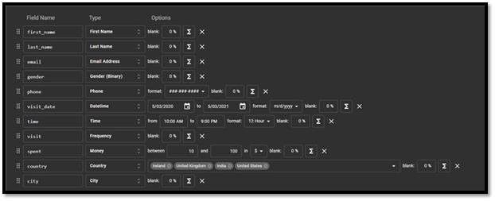
Data Creation
To build mock data for this project, we used the MOCKAROO website. The datasets are then used to help our project in Dynamics and Power BI.
The below figure shows the table used for differentiating the customers on the basis of visiting frequency. The main column was visit frequency. The other columns that were found important are email, visit date, and phone number.

Slide 13
IMPLEMENTATION

Slide 14
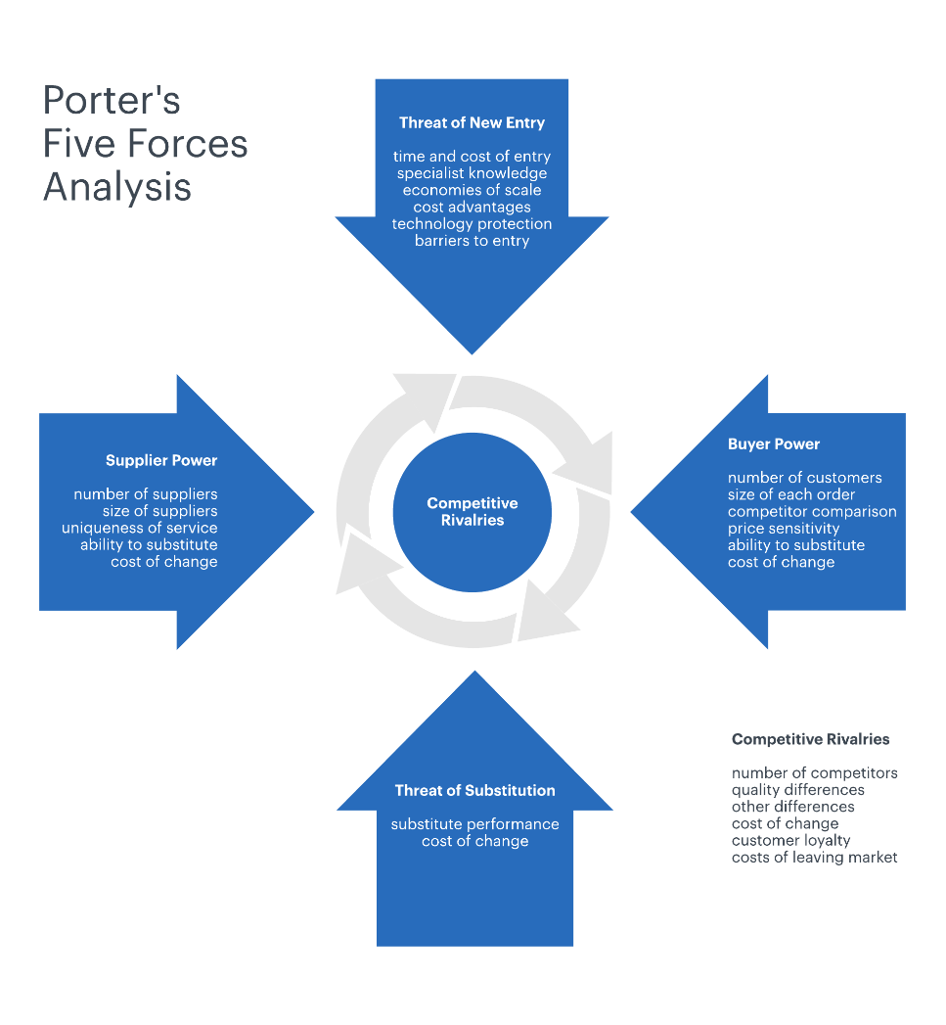
Porter’s Five Force Implementation
The Porter Five Forces model was developed by Harvard Business School professor Michael Porter to analyze an industry's potential and probable benefit. It has since become the gold standard for assessing a company's strength and weaknesses in the market. We go through the five powers in our business and explore how they are applied in our situation.

Slide 15
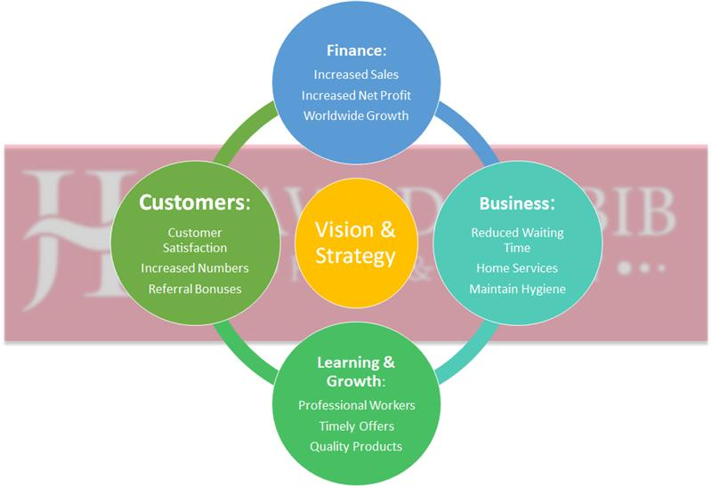
Balanced Score Card
Any organization should follow a balanced scorecard. The vision of Javed Habib Hair & Beauty is set higher in order to achieve goals. Many of the areas in the balanced scorecard get a lot of attention.
The company Balance Score Card consists of following main goals as shown in figure below.

Slide 16
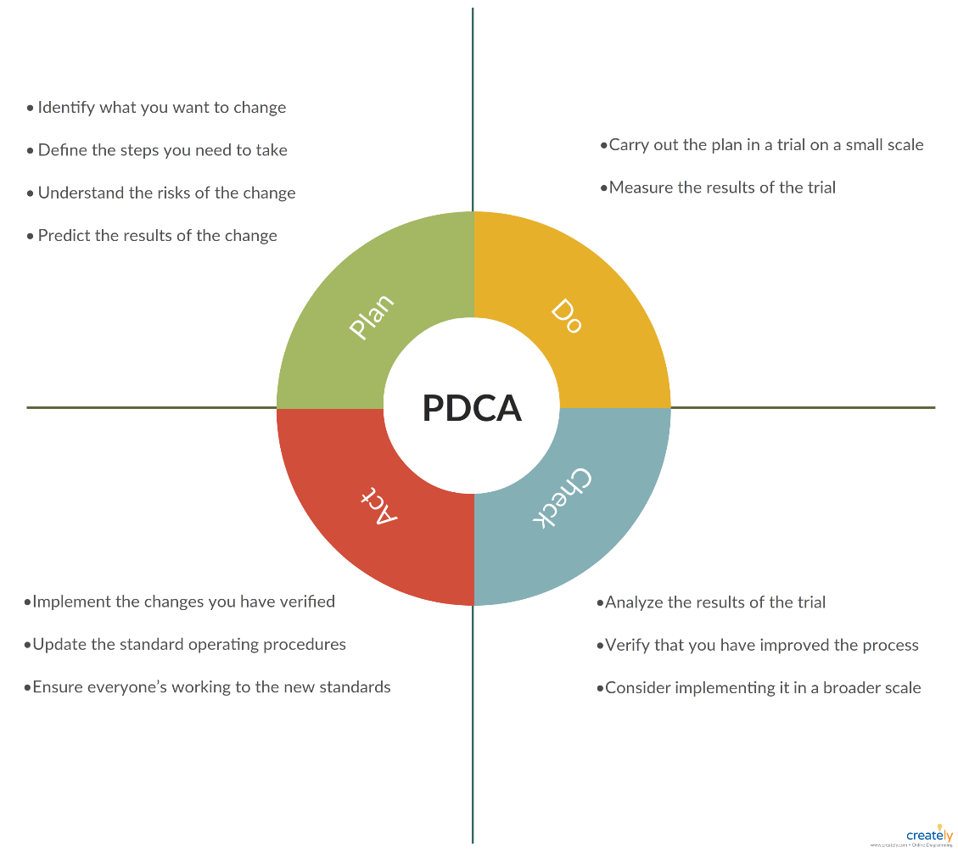
PDCA Cycle
PDCA stands for PLAN-DO-ACT-CHECK.
It has 4 steps for carrying out this model.
It's called a cycle because it's a constantly changing mechanism that requires constant supervision. Each phase is clearly illustrated in the diagram below.

Slide 17
Plan: Many clients who did not show up or cancelled their appointments did not turn into business opportunities, according to the findings. This meant that future business was affected as a result of the failure to follow up on missed appointments.
DO: Before a plan can be executed on a larger scale, it must first be plotted. We must consider its benefits as well as any problems that might arise. It's also important not to put too much money into a method that hasn't been proven.
Check: We can differentiate the benefits after looking through the system. Customers who cannot hold their previous appointment readily consent to reschedule. Clients who do not turn up agree to book again in order to receive benefits
ACT: The platform is now ready for larger-scale implementation. To put the device in place, the salons at all of the locations are accessed.

Slide 18
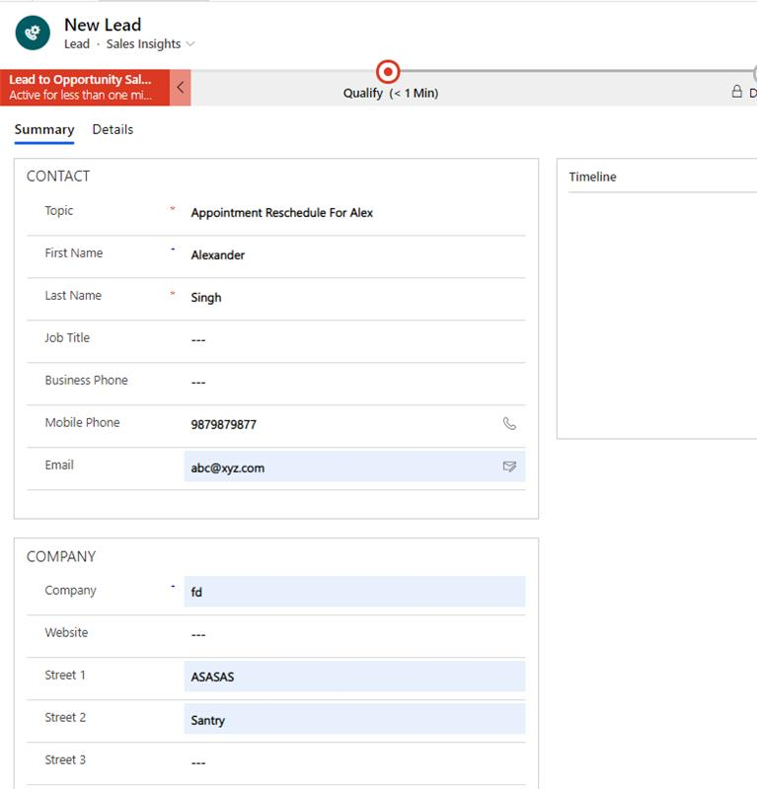
Implementation of Dynamics CRM
Dynamics CRM is used to connect various system entities easily.
We analyze a case of appointment rescheduling in dynamics for the sake of visualization. After a call to reschedule an appointment, a lead is provided.

Slide 19
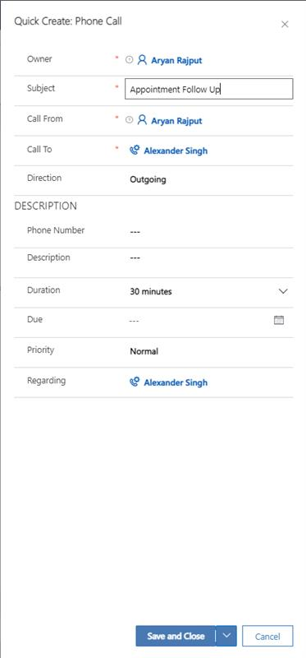
Here, we make a call from our end to imagine the next steps in the process and comprehend the whole procedure.

Slide 20
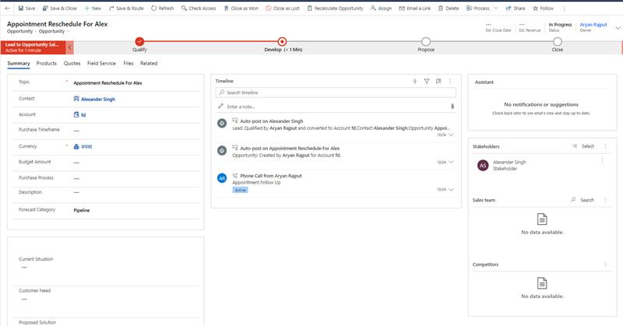
Before any more procedures are implemented, any call to the system must be checked. There is a step before we can mark the call as a legitimate ticket that must be handled.

Slide 21
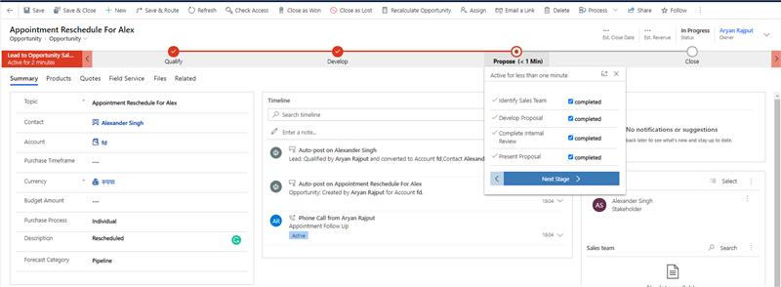
The ticket is sent to the appropriate team, which examines it for validity. In our situation, the teams look for alternative scheduling options.

Slide 22
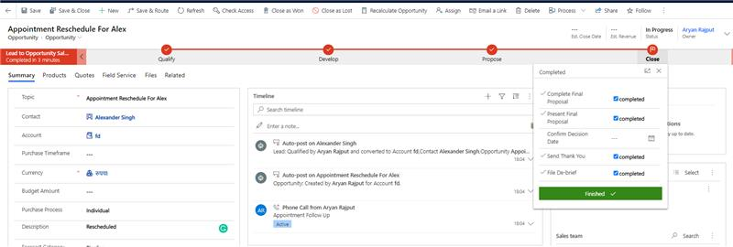
A token for case closure is generated after the ticket has been completed. In our situation, the caller is informed of the new time after a satisfactory reschedule.

Slide 23
IMPLEMENTATION OF TABLEAU FOR DASHBOARD
We used tableau for our Dashboard creation. Special notice was given implement all types of dashboard types.
Strategic: They're used to visualize and align the company's strategic priorities.
Tactical: Important tasks and their progress are often visualized in order to check up on whether or not the objectives have been reached.
Operational: In these dashboards, small-scale operations and business processes are visualized.

Slide 24
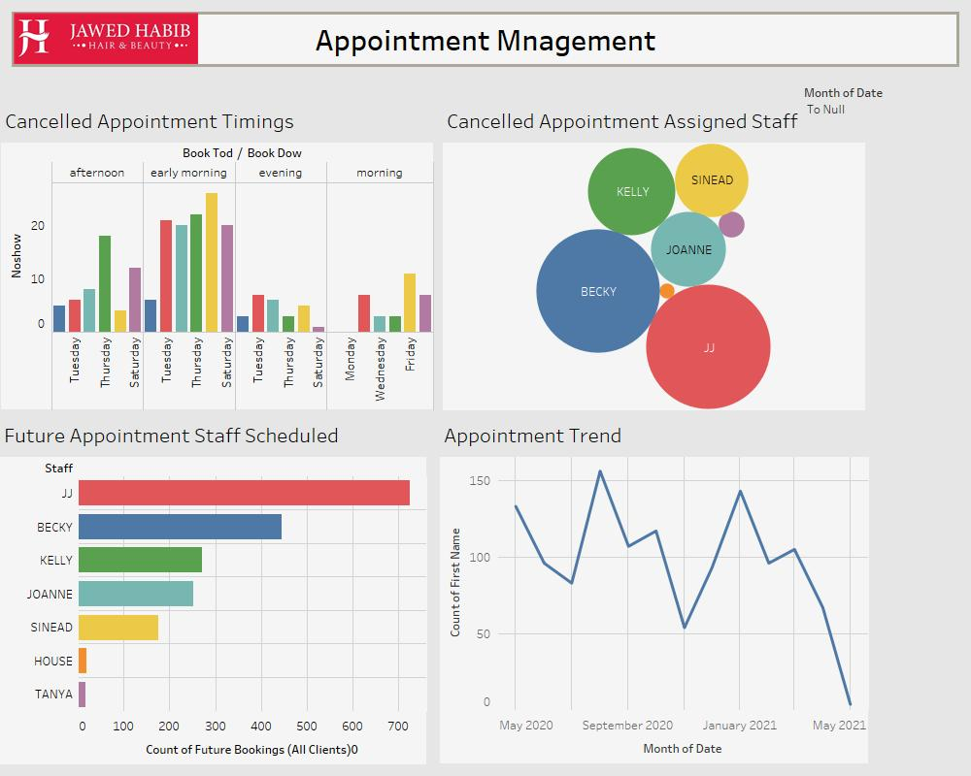
First Dashboard
The first Dashboard is about Appointment Management of our company.
The first bar-plot shows the appointment times that have been canceled. It tells us the days of the week and times of day have the most no shows. This generally refers to the underlying cause of the phenomenon.

Slide 25
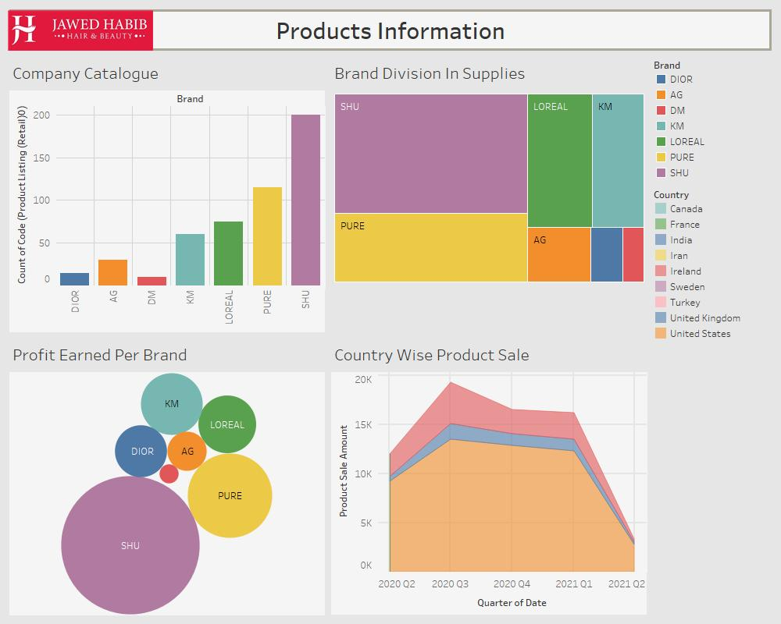
Second Dashboard
The information about our suppliers is shown on the second dashboard. We will keep track of our supplier's count and the level of control the business has over its suppliers.

Slide 26
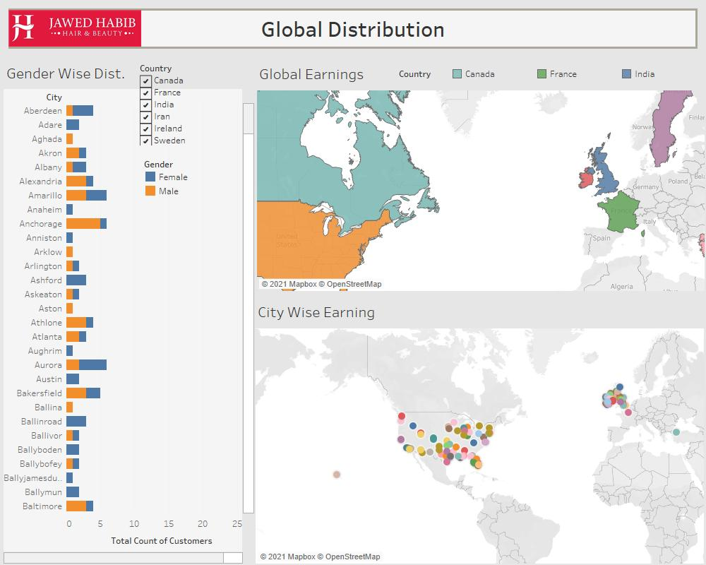
Third Dashboard
The third dashboard is responsible for showcasing our global scope. Signifies the reach of the country and customer demographics.

Slide 27
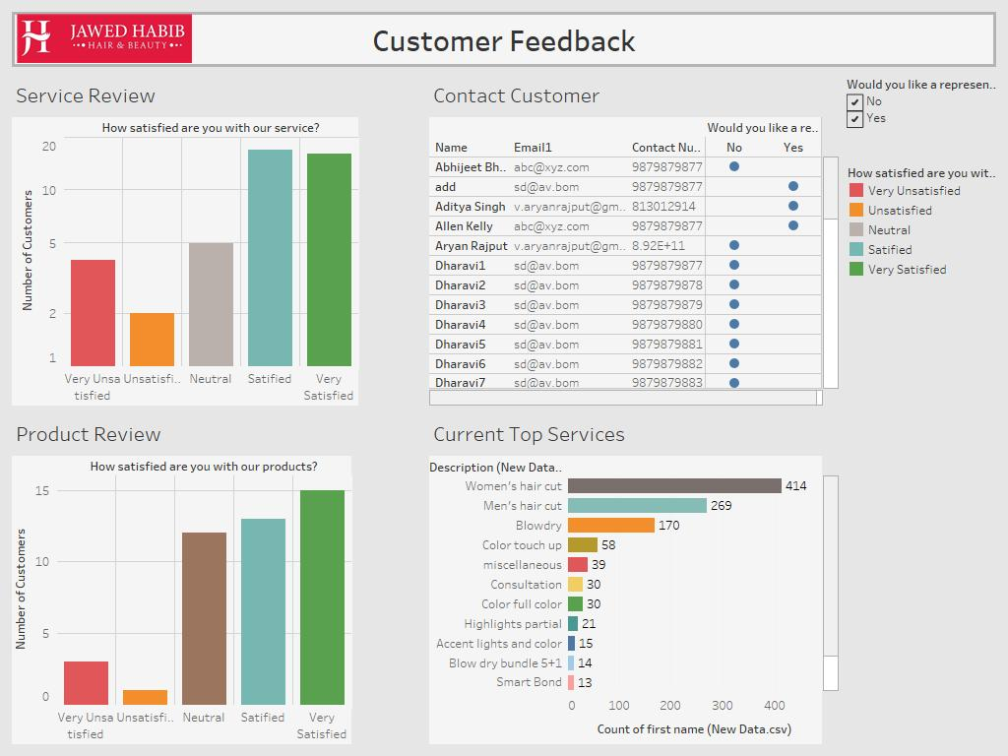
Feed Back Data
The below dashboard is a visualized data of all data received from the online feedback after being sent to the support team.

Slide 28
THANK YOU

